Slide 1
Introduction to Shiny
PsyTeachR Shiny Tutorials
https://psyteachr.github.io/shiny-tutorials/

Slide 2


Slide 3
What is Shiny?
R package that allows you to create interactive GUIs in R
Highly flexible and customisable
Applications
Intuitive tools for science
Presenting results
Collecting data
Teaching

Slide 4
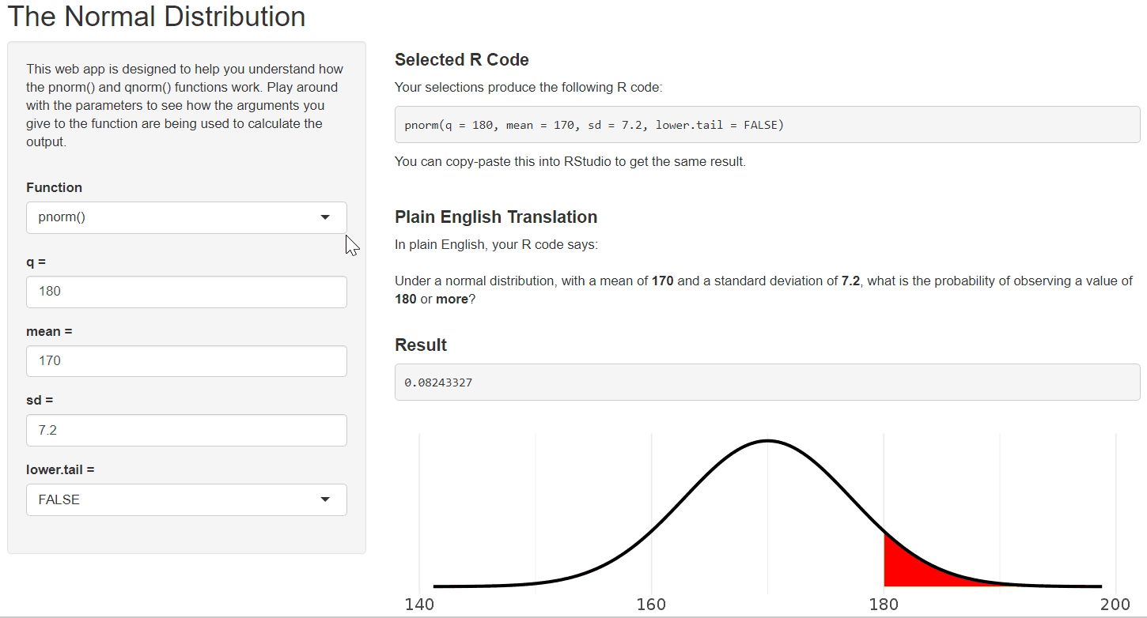
http://shiny.psy.gla.ac.uk/ShinyPsyTeachR/ug1/normal-distributions/

Slide 5
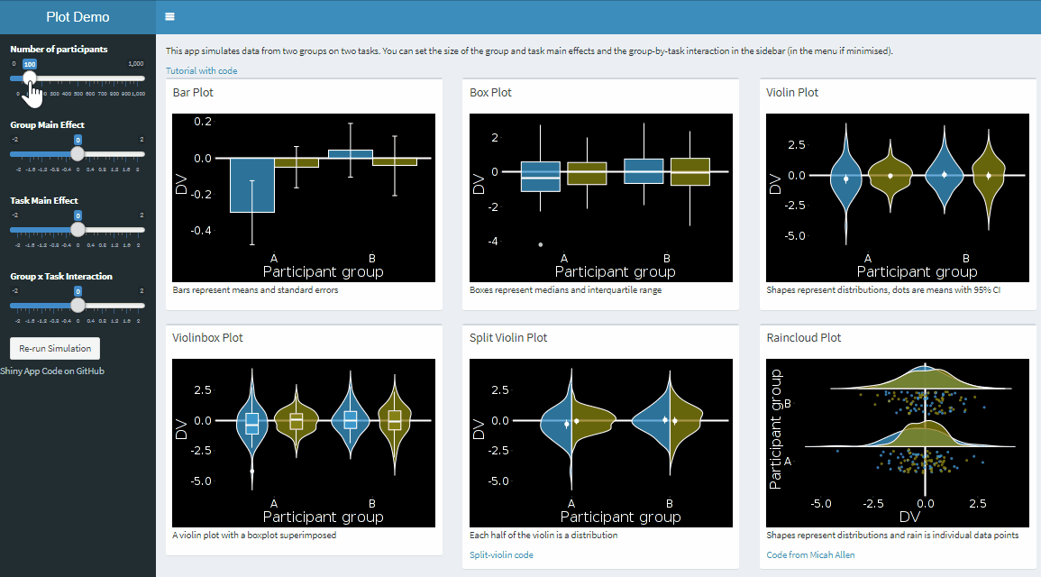
http://shiny.psy.gla.ac.uk/debruine/plotdemo/

Slide 6
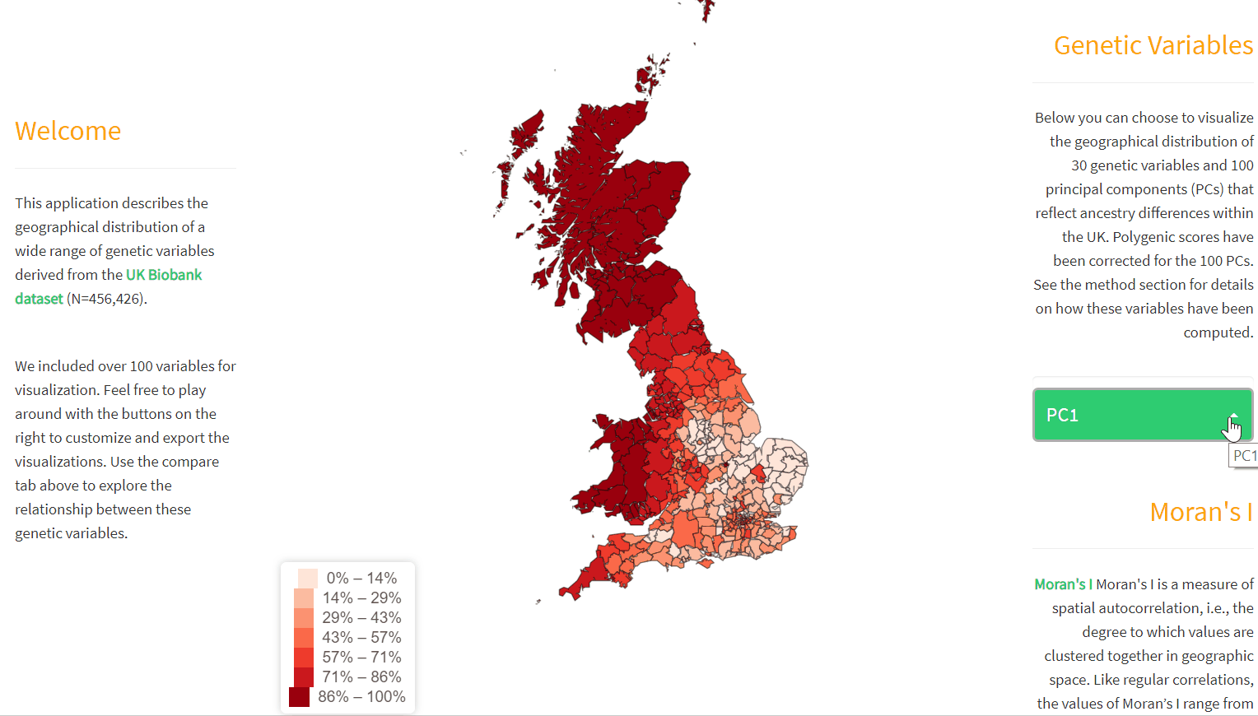
https://holtzyan.shinyapps.io/UKB_geo/

Slide 7
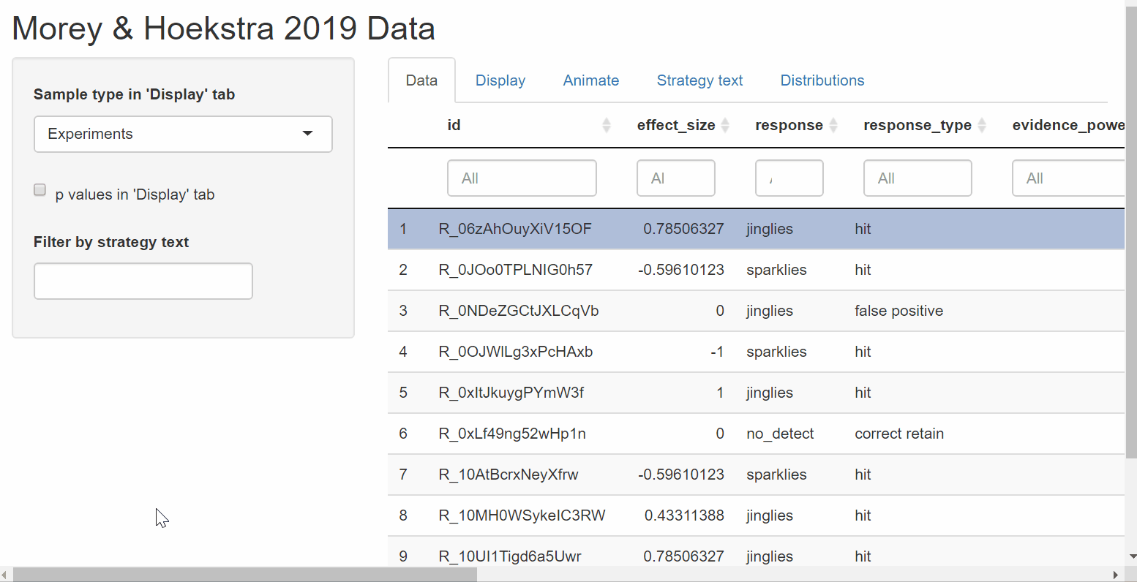
https://richarddmorey.github.io/Morey_Hoekstra_StatCognition/index.html

Slide 8
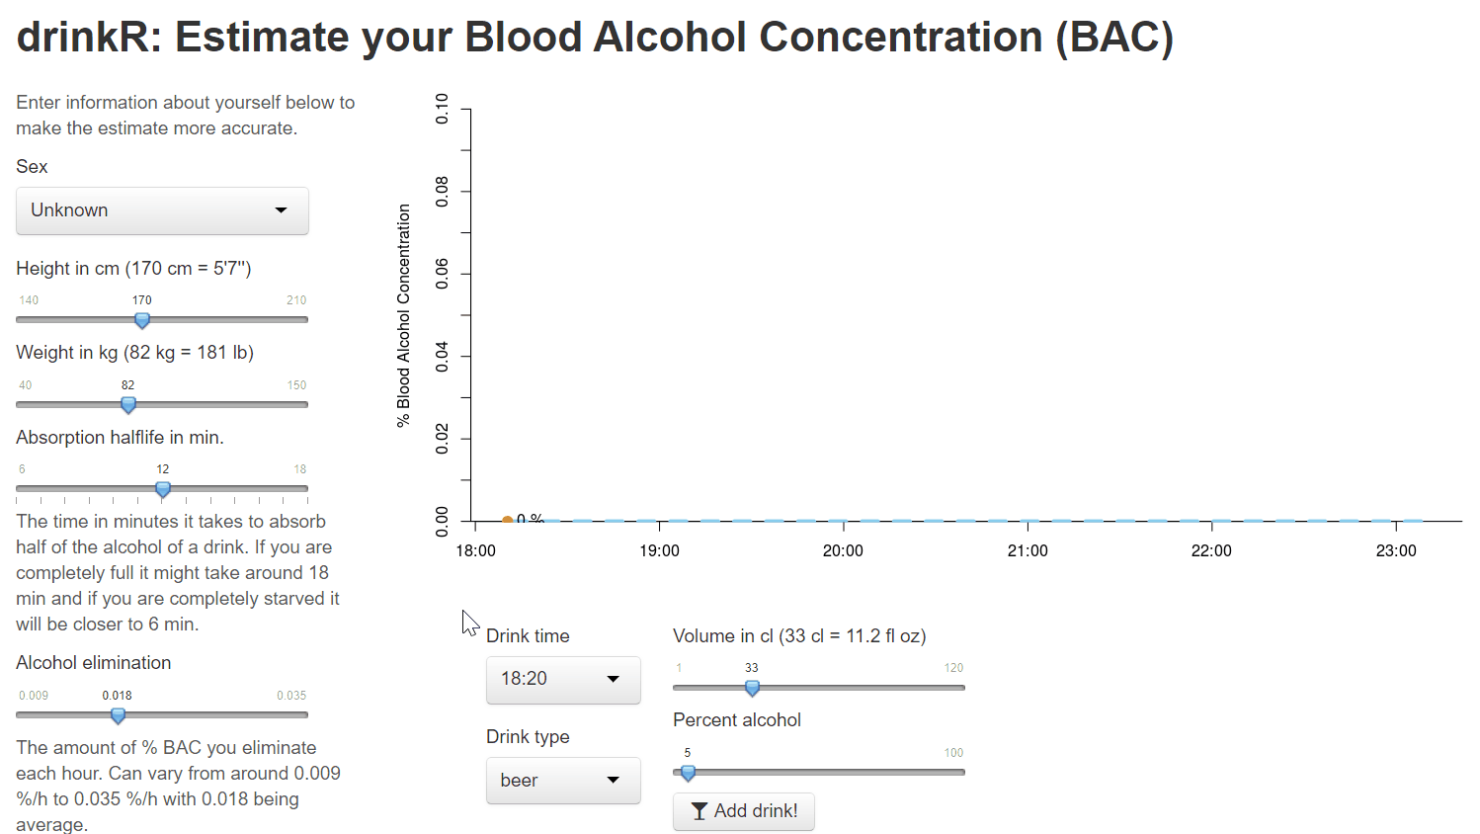
https://gallery.shinyapps.io/drinkr/

Slide 9
How does Shiny work?
ui
server
Runs once
Specifies the user interface
Defined as an object
Stable and unchanging
Runs continually
Specifies the logic
Defined as a function
Can change in response to input

Slide 10
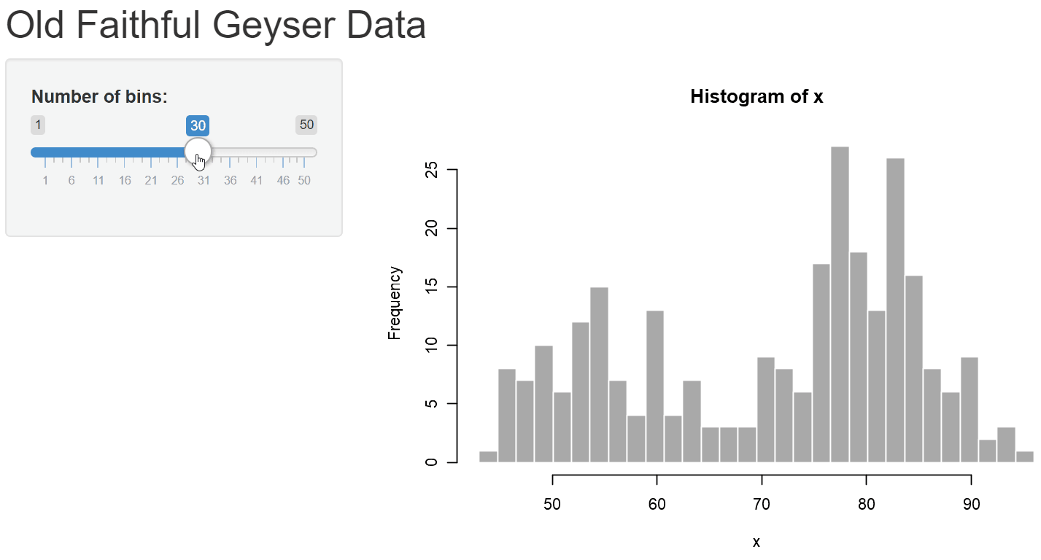
Old Faithful

Slide 11
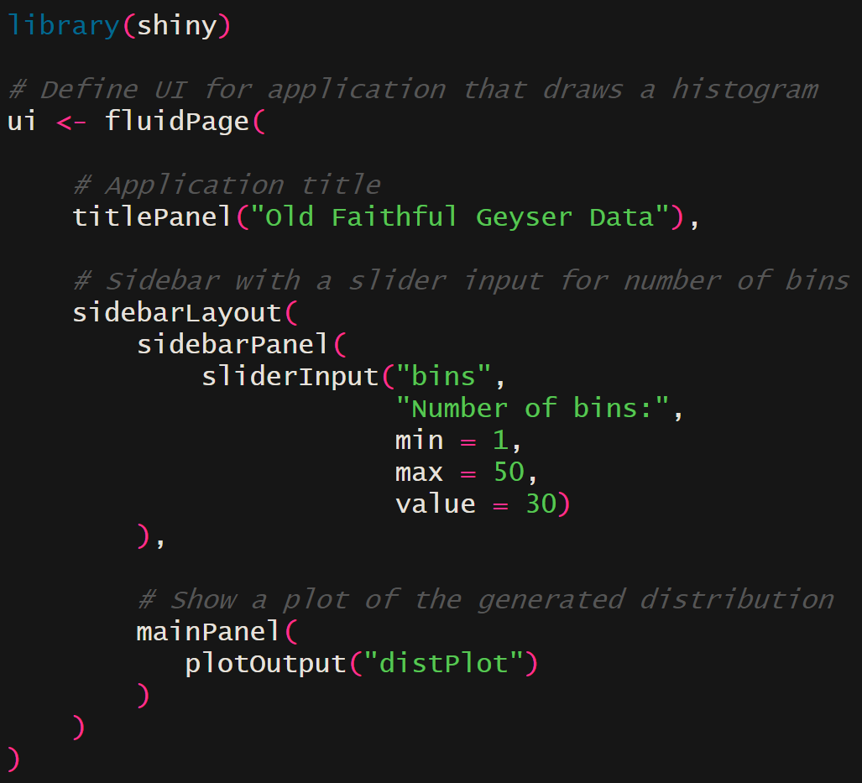

Old Faithful - UI
ui
titlePanel
sidebarLayout
sidebarPanel
mainPanel
sliderInput
“bins”
plotOutput
“distPlot”

Slide 12
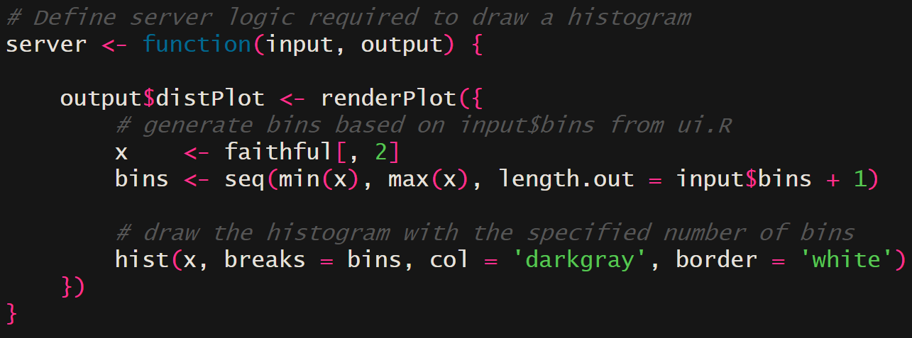
Old Faithful - Server

Slide 13

Old Faithful - Server

Slide 14
Old Faithful
ui
titlePanel
server
sidebarLayout
renderPlot
output$distPlot
sidebarPanel
mainPanel
sliderInput
“bins”
plotOutput
“distPlot”

Slide 15
Old Faithful - Reactivity
ui
titlePanel
server
sidebarLayout
renderPlot
output$distPlot
sidebarPanel
mainPanel
sliderInput
“bins”
plotOutput
“distPlot”

Slide 16
Sharing/Deploying Shiny Apps
Running Locally
The easiest way to share a Shiny app is by sharing the code (e.g. on GitHub). These can then be downloaded and run locally.
Running Online
If you want to make your Shiny app available as a web app online you will need a Shiny server:
You can deploy to https://www.shinyapps.io/ for free
If you have a web server, you can host your own Shiny server
UoG Psychology Department has a Shiny server

